Slide 1
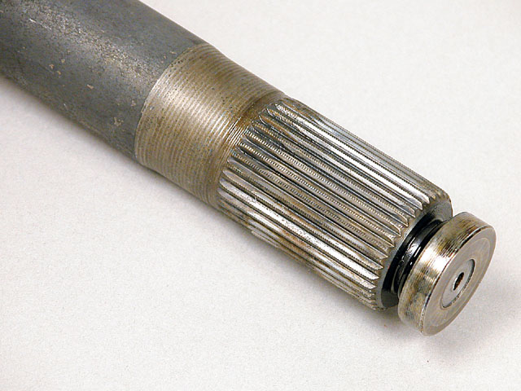
MECH 325 Shaft Accessories

Slide 2
Objectives
By the end of this section, you should be able to:
Identify shaft accessories (keys, pins, splines, etc.) and select an accessory of suitable size
Identify shaft coupling components: U-joints, lock-nuts, retaining rings, etc.

Slide 3
Use of Shaft Shoulders
Shoulders can also increase mounting stiffness for components
Gear
Gear

Slide 4
Uses of Shaft Accessories
What are the desirable characteristics for:
A component (e.g. gear or pulley) mounted to a shaft
A bearing mounted to a shaft
Two shafts connected together

Slide 5
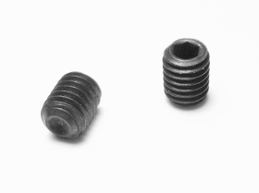
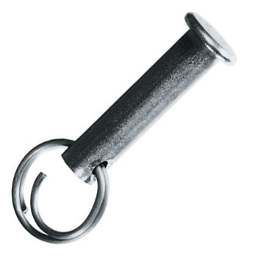
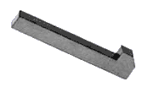
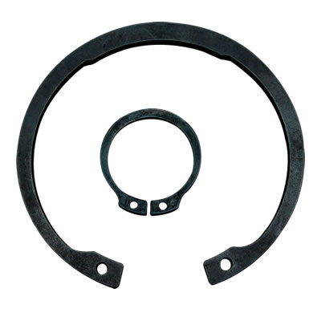

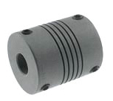
Shaft Accessories
Setscrews
Pins
Keys
Retaining Rings
Splines
Couplings

Slide 6
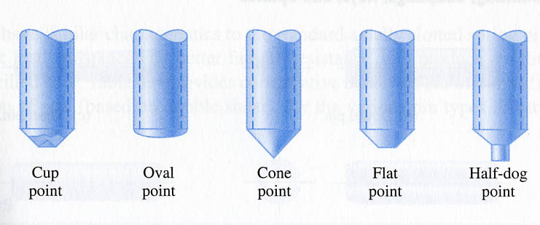
Set Screws
Cup point: most common; for ductile materials
Oval point: uses groove or keyway for spotting on shaft
Cone point: ductile shaft; when no adjustment is needed
Flat point: hardened steel shafts; for frequent adjustment and low torque
Half-dog point: for relative positioning; need a mating hole in the shaft

Slide 7
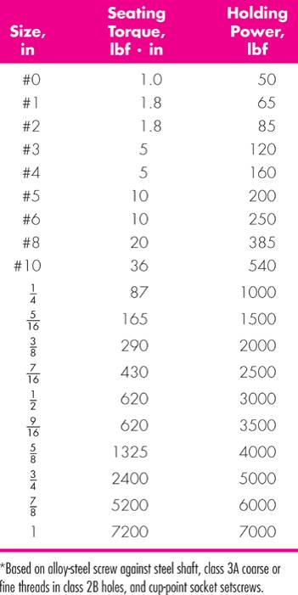
Set Screw Sizing
Holding “power” (force)
for resisting torque and axial force
e.g.:
Set screw
D
T
shaft
hub
gear or pulley

Slide 8
Team Exercise
In your teams, look through the notes and discuss each of the shaft accessories in terms of:
- The intended use(s)
- How the component is fixed
- How the component fails (fractures or stops functioning)
15 minutes to review and then random teams will asked to present to the class.

Slide 9
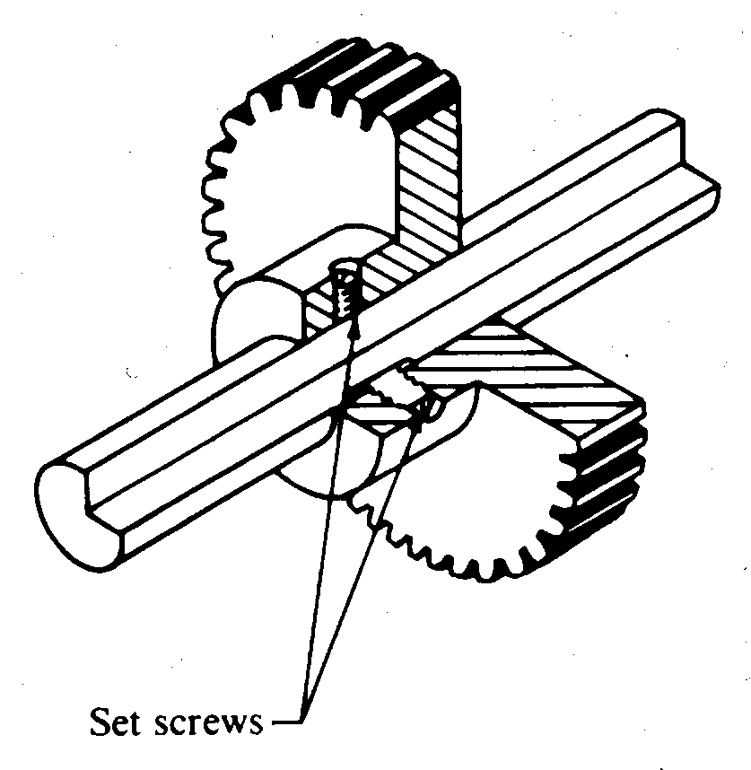
Set Screws
Often used in pairs
A flat, a slot, or a hole machined into the shaft will significantly increase torque transmission

Slide 10
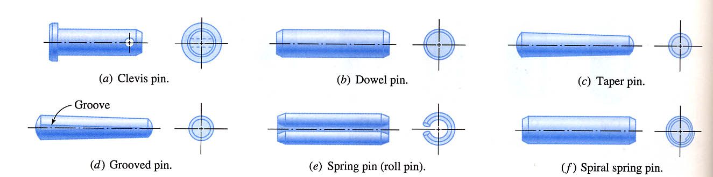
Pins
Clevis pin: for quick detachment
Dowel pin: for precise location
Taper pin: like dowel pins; self locking
Grooved pin: many shapes; flexes to provide self-locking
Spring pin: easy assembly; less critical tolerances than solid pins
Spiral spring pin: similar to spring pins with better shock and fatigue resistance

Slide 11
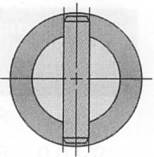
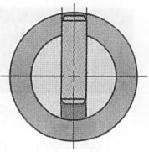
Loading on Pins
D
T
shaft
Double shear
hub
gear or pulley
pin
Single shear

Slide 12
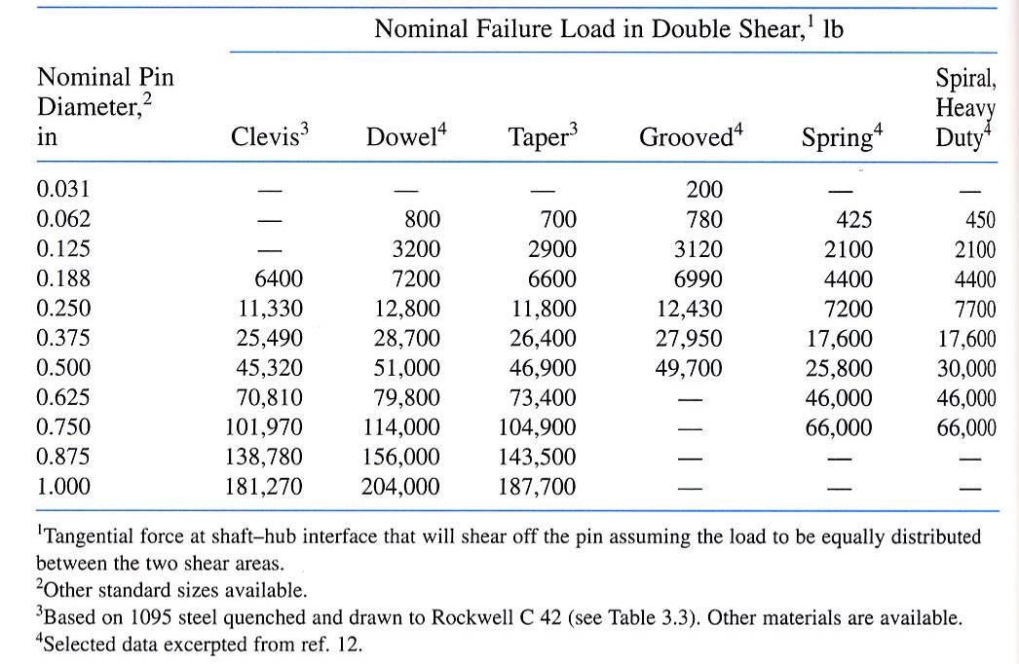
Pin Failure Loads

Slide 13
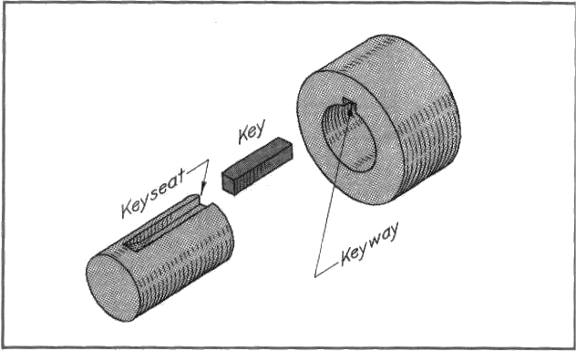
Keys
Want key to fail before shaft (“mechanical fuse”)
Generally choose soft, ductile material

Slide 14
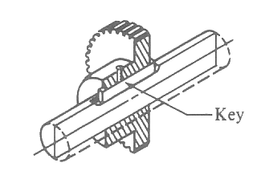
Keys
F ≈
Failure from Shear
Solve for key length, L
w
H

Slide 15
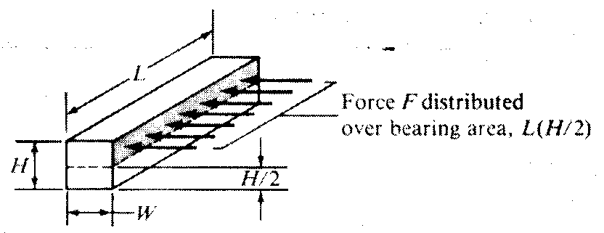
Keys
Failure from compression
Force distributed over bearing area (L H/2)
Solve for key length, L

Slide 16
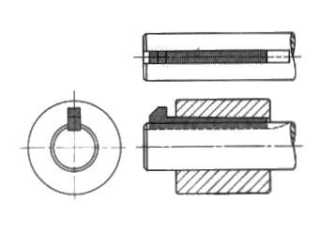
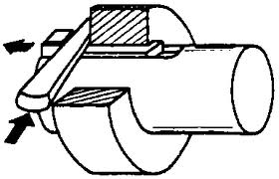
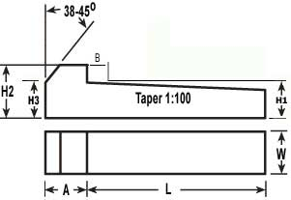
Gib-Head Key
Disadvantage:

Slide 17
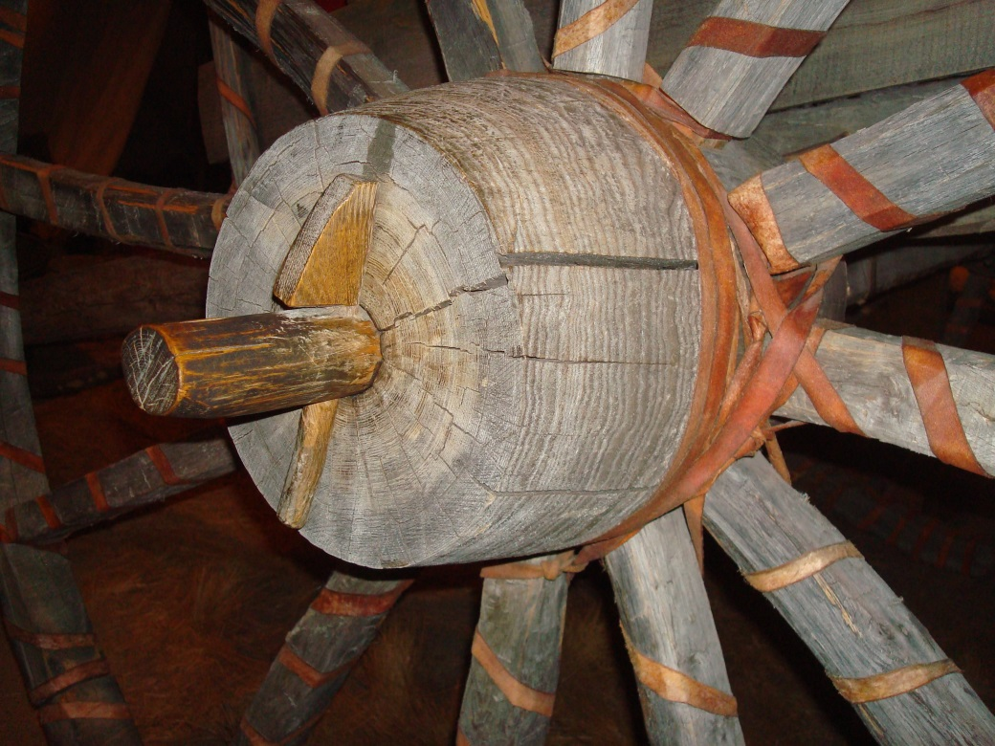
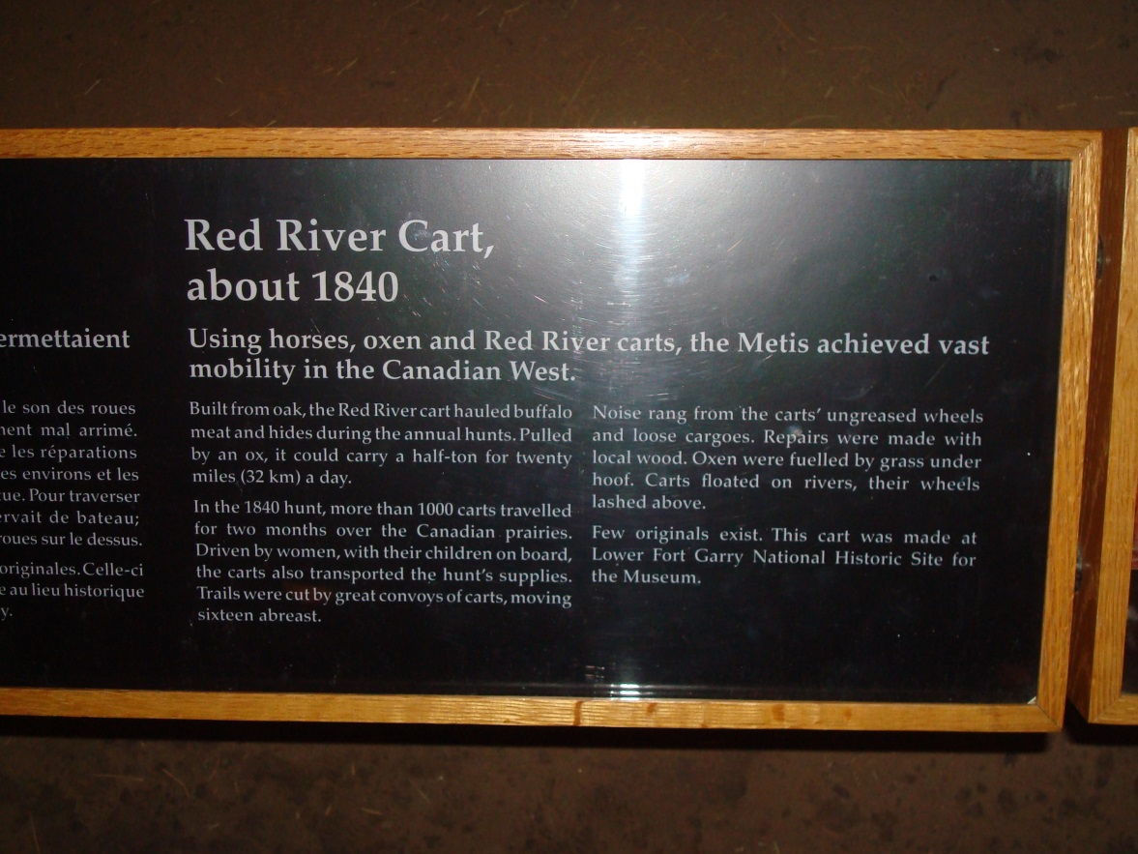

Slide 18
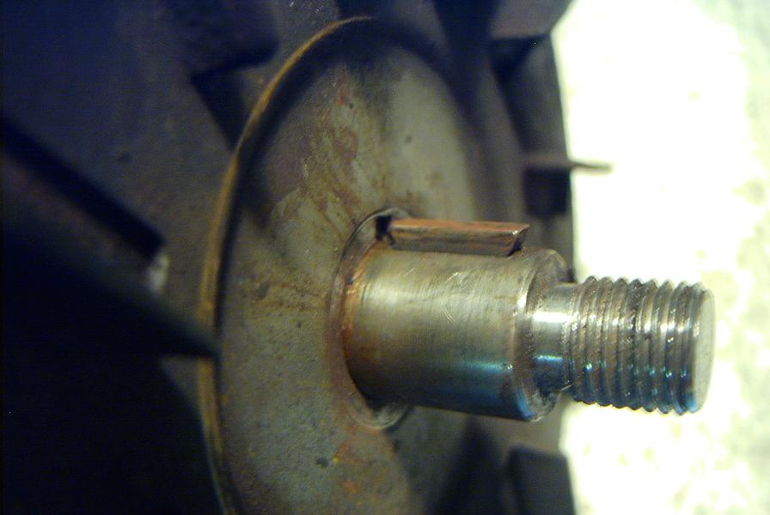
Woodruff Key Use
Easy to install / remove
Analysis similar to square keys

Slide 19
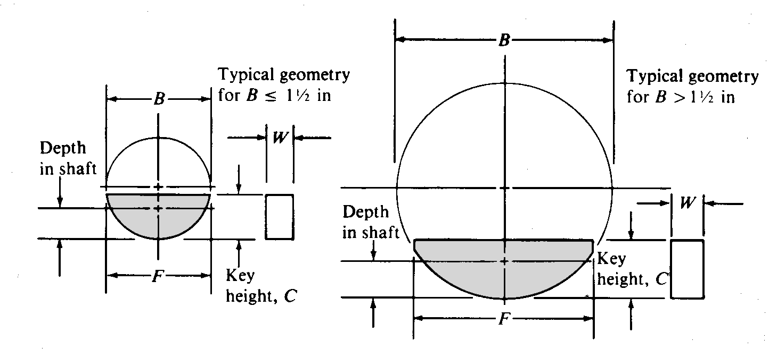
Woodruff Key Geometry (Ref.)
Same analysis as rectangular keys above – geometry is different

Slide 20
Woodruff Keys: Areas
B/2
W
d_{s}
Shear Area
Bearing Area
C

Slide 21
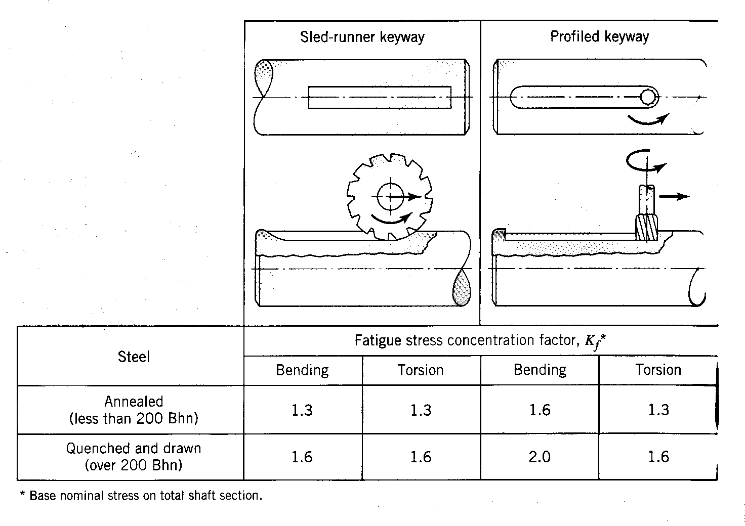
Keyway Stress Concentrations

Slide 22
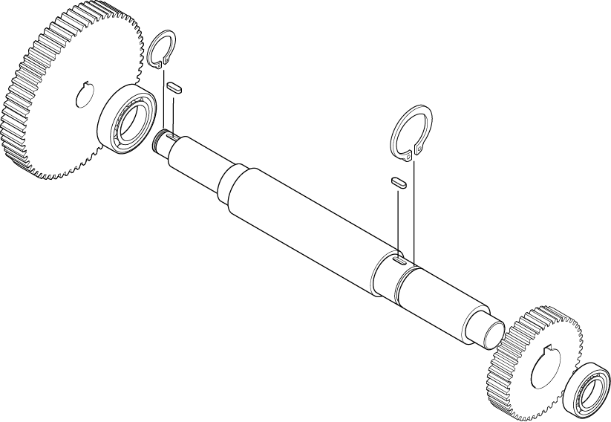
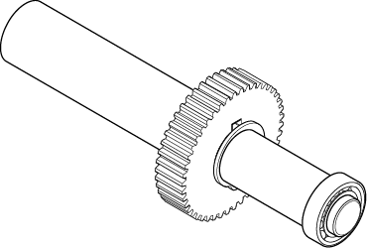
Retaining Rings
Seat in grooves on the shaft to prevent axial motion of supported members
Introduces stress concentration
Internal or external
Shoulder height and axial thrust capacity varies (see table and file on Vista)

Slide 23
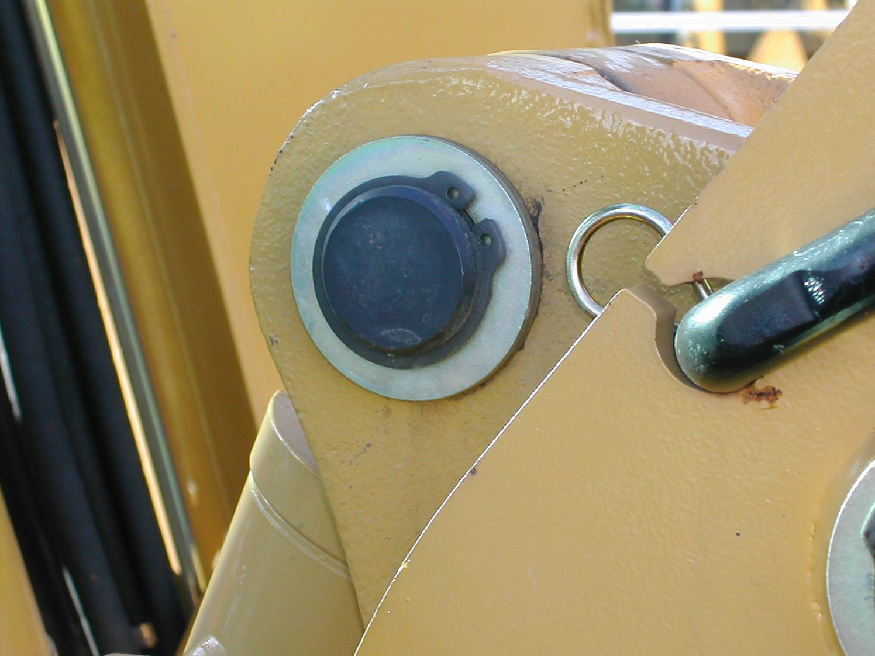
Retaining Ring Example

Slide 24
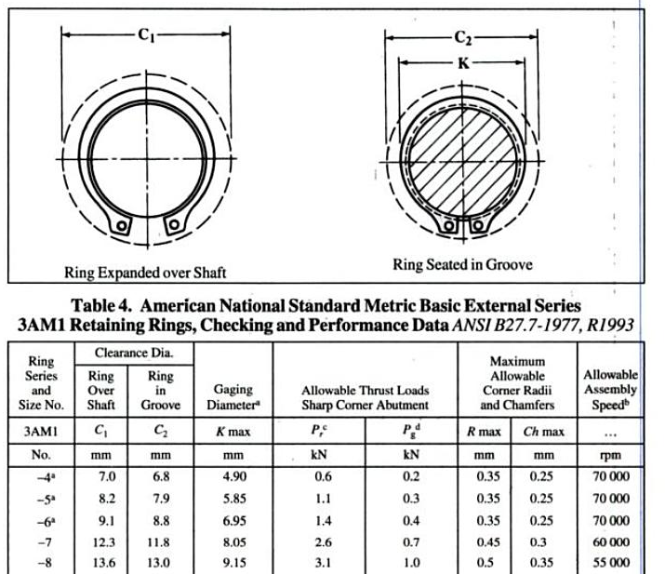

Slide 25
Retaining Ring Failure Loads
Retaining Ring Failure
(Ring Shear)
Groove Failure
(Groove Yield)
Thrust load, P
Thrust load, P
Shaft diameter D
groove depth d
Ring width t

Slide 26
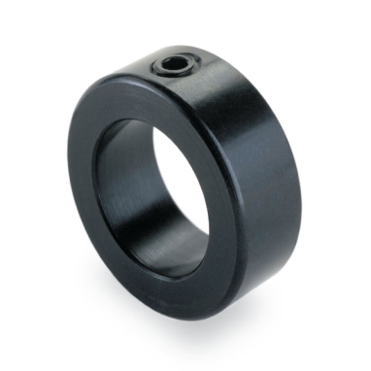
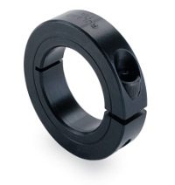
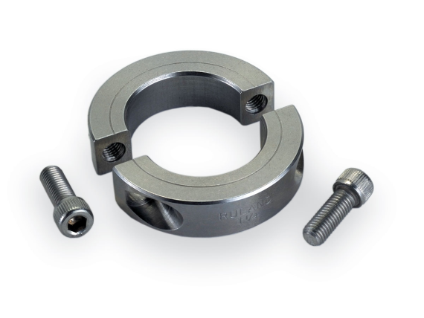
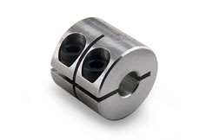
Shaft Collar
Like a “moveable shoulder” on the shaft
Set screw-style
Size using set screw relationships above
Shaft material should be softer than set screw
Clamp-style
Available in one-piece or two-piece
Holding power based primarily on
screw size and material
One piece good for accessible ends
of shafts
Two piece has about 10% more holding power
than similar one piece
Also available in double-wide for
extra holding power

Slide 27
Shaft Collar Axial Capacity
Approximate Axial Load Capacity* for Two-Piece Split Collar** Alloy Socket Head Cap Screw
Screw Size | Maximum Screw Torque (in-lbs) | Axial Holding Power (lbs)
4-40 | 14 | 235
6-32 | 26 | 355
8-32 | 46 | 546
10-32 | 67 | 785
¼-28 | 196 | 1510
5/16-24 | 416 | 2412
3/8-24 | 718 | 3653
½-20 | 1755 | 6657
* Based on typical conditions - will vary based on material and installation conditions
** Reduce axial holding power by roughly 10% for one-piece split collar

Slide 28
Shaft Collar Axial Capacity
Approximate Axial Load Capacity* for Two-Piece Split Collar** Alloy Socket Head Cap Screw (Metric)
Screw Size | Maximum Screw Torque (N-m) | Axial Holding Power (kN)
M3x0.5 | 2.2 | 1.4
M4x0.7 | 5.0 | 2.4
M5x0.8 | 10.2 | 3.9
M6x1 | 17.3 | 5.6
M8x1 | 45.0 | 10.9
M10x1.25 | 87.8 | 17.0
* Based on typical conditions - will vary based on material and installation conditions
** Reduce axial holding power by roughly 10% for one-piece split collar

Slide 29
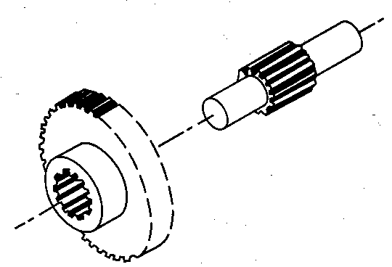
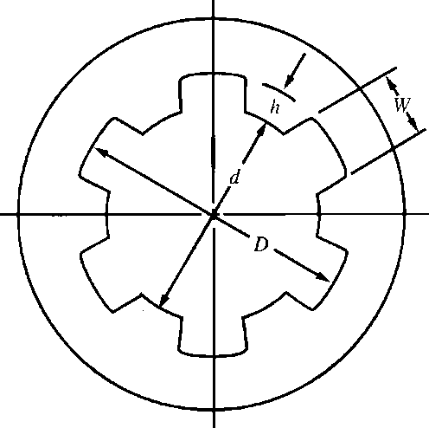
Splines
Analogous to a gear or a series of axial keys
Provides greater torque transmission
Axial sliding motion is possible
Splines are often hardened against wear due to axial motions
Splines also facilitate changes to the angular orientation of a shaft mounted element
Straight sided or involute

Slide 30
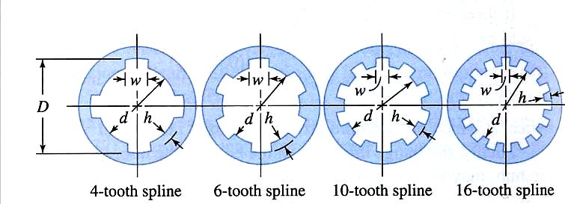
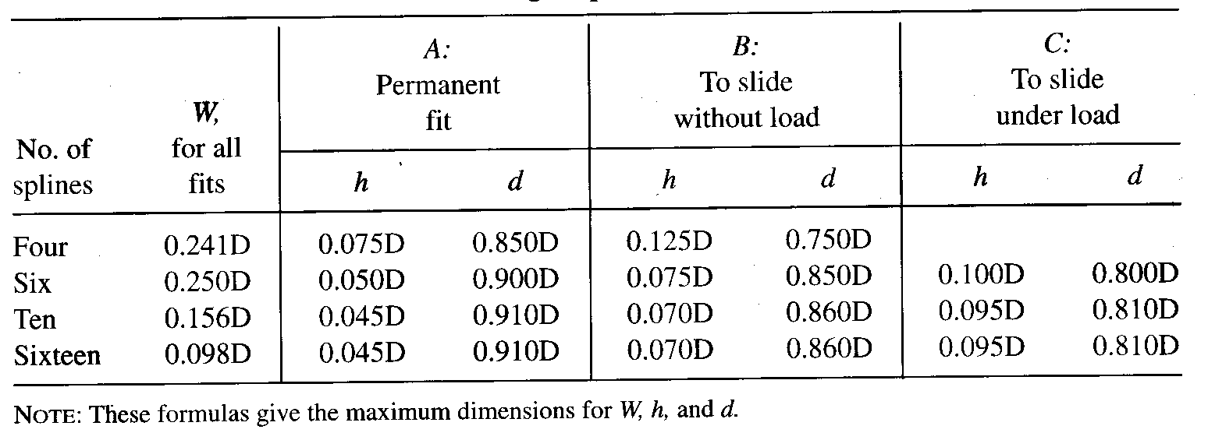
Standard Dimensions

Slide 31
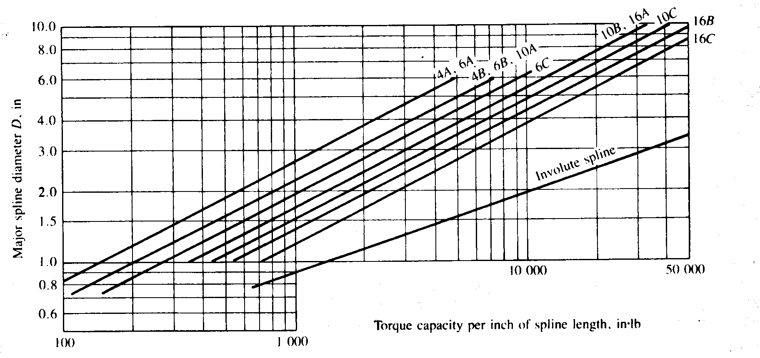
Spline Torque Capacity
How much torque can a 5-in diameter, 4 tooth spline with a permanent fit transmit?

Slide 32
Rigid Couplings
Advantages:
Shafts must be well supported by bearings

Slide 33
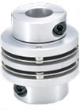
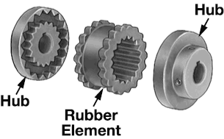
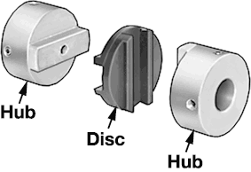
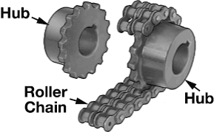
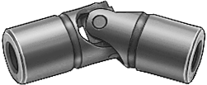
Flexible Couplings
Flexible Sleeve
Δθ = ±1° δ = low
Bellows
Δθ = ± 9° δ = ± ¼“
Flex Disk
Δθ = ± 1° δ = ± 1/16“
Sliding Disk
Δθ = ±1/2° δ = 1/4”
U-Joint
Δθ = ± 15°
Roller Chain
Δθ = ± 1.5° δ = ± 0.01“

Slide 34
Design Scenario
Identify the components you would use to assemble the machine shown
Motor
Mixing Tank
Bearing
& Seal
Shaft with
Bearings
Impeller
Shaft
V-Belt
Drive
Impeller

Slide 35
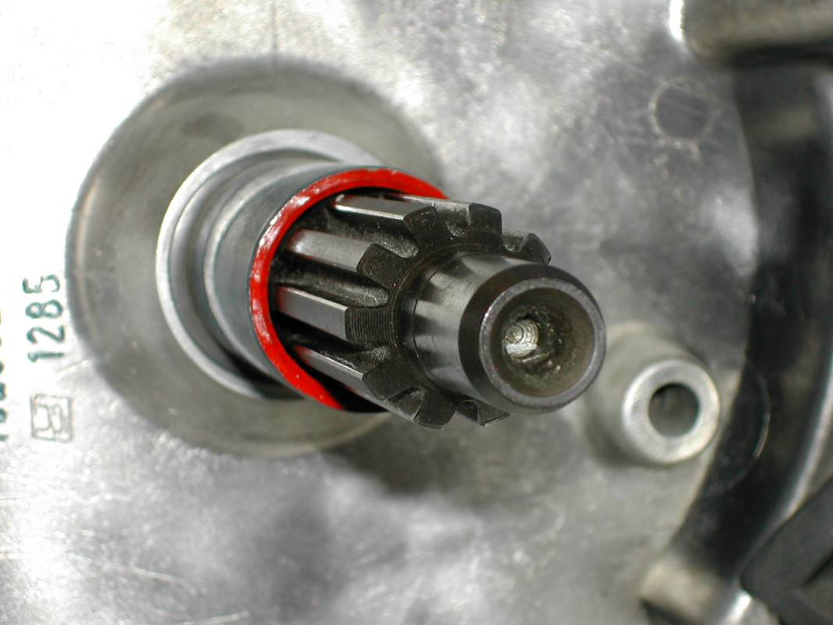
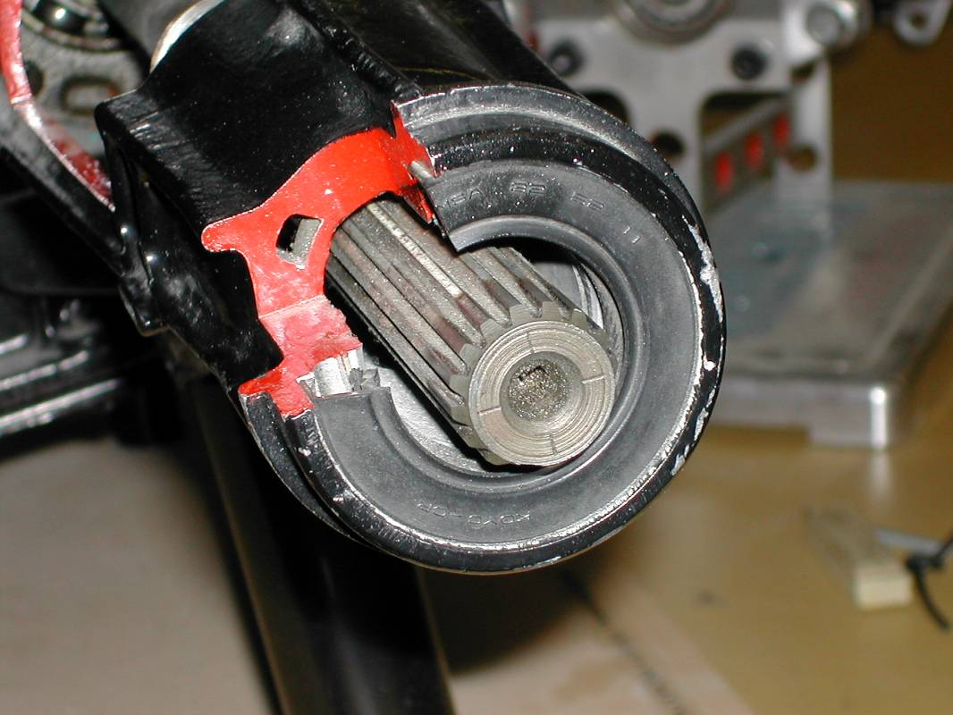
Spline Examples

